Slide 1
Employee Data Analysis using Excel
STUDENT NAME:RUBINI R
REGISTER NO: 00F7EF38CF27BC59E914D500BE3E6C86 , 312208760
DEPARTMENT:B.COM (GENERAL)
COLLEGE : MEENAKSHI COLLEGE FOR WOMEN

Slide 2
PROJECT TITLE
Employee Performance Analysis using Excel based on Male employee type, Department, FTE, Salary Analysis

Slide 3


AGENDA
Problem Statement
Project Overview
End Users
Our Solution and Proposition
Dataset Description
Modelling Approach
Results and Discussion
Conclusion
3/21/2024 Annual Review

Slide 4

PROBLEM STATEMENT
The purpose of Full-Time Equivalent (FTE) is to standardize the measurement of employee work hours, regardless of whether they work full-time or part-time, in order to better manage, allocate, and analyze workforce resources.

Slide 5

PROJECT OVERVIEW
Employee analysis involves examining various aspects of the workforce to gain insights that can help in decision - making, improving efficiency, and enhancing employee satisfaction.

Slide 6

WHO ARE THE END USERS?
•HUMAN RESOURCE DEPARTMENTS •MANAGEMENT AND LEADERSHIP •TEAM LEADERS AND SUPERVISORS
•EMPLOYEES
•EXECUTIVE LEADERSHIP
•BUSINESS ANALYSTS
•RECRUITERS

Slide 7

OUR SOLUTION AND ITS VALUE PROPOSITION
FILTERING- REMOVE VALUES
PIVOT TABLE -SUMMARY OF EMPLOYEE PERFORMANCE
BAR DIAGRAM -FINAL REPORT

Slide 8
Dataset Description
• EMPLOYEE DATA SET-NAN MUDHALVAN PORTAL
• 9 FEATURES IN EXCEL:
EMPLOYEE ID-ALPHANUMERIC(TEXT)
NAME-ALPHABETICAL(TEXT)
GENDER-ALPHABETICAL(TEXT)
DEPARTMENT -ALPHABETICAL(TEXT)
SALARY -NUMERICAL
START DATE -ALPHANUMERIC(TEXT)
FTE-NUMERICAL
EMPLOYEE TYPE-ALPHABETICAL(TEXT) EMPLOYEE LOCATION-ALPHABETICAL(TEXT)

Slide 9

THE "WOW" IN OUR SOLUTION
•Effective data visualization makes it easier to present complex data in an engaging and understandable way.
•Well-presented data can have a significant impact on decision-makers, helping to drive change and innovation.
3/21/2024 Annual Review
9

Slide 10
MODELLING
•STEP -1
DOWNLOAD THE EMPLOYEE DATASET AND OPEN THE EMPLOYEE DATASET IN EXCEL.
•STEP -2 SELECT THE ENTIRE DATA AND CLICK ON DATA AND CLICK ON FILTER OPTION.
•STEP -3 FILTER FTE FROM A TO Z ORDER.
•STEP -4 SELECT THE ENTIRE DATA AND CLICK ON INSERT AND CLICK ON PIVOT TABLE TO CREATE PIVOT TABLE.
10

Slide 11
• STEP -5
DRAG THE NEEDED DATA AND CREATE A PIVOT TABLE.
•STEP -6
SELECT THE PIVOT TABLE AND CLICK ON INSERT.
•STEP-7
NOW CLICK ON THE CHART THAT YOU WANT.
•STEP -8
THE CHART IS CREATED

Slide 12
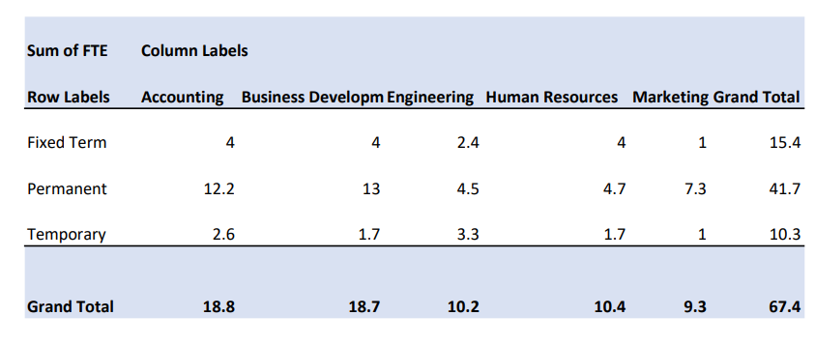
RESULTS
1.TABLE :
12

Slide 13
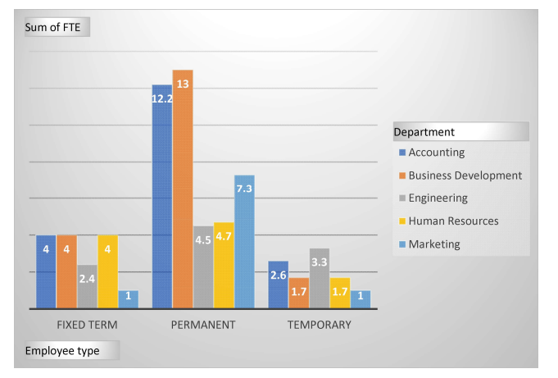
2. BAR DIAGRAM:

Slide 14
conclusion
Analyzing employee performance based on departments, employee type, and Full-Time Equivalent (FTE) using Excel provides crucial insights into workforce dynamics and organizational efficiency. By breaking down performance metrics across different departments, it becomes easier to identify areas of strength and those needing improvement. Evaluating employee types-such as full-time, part-time, and contract workers-helps in understanding their respective contributions and informs decisions on hiring and resource allocation. Additionally, analyzing performance in relation to FTE allows for a fair comparison across employees with varying workloads, ensuring a balanced assessment of productivity. Excel's powerful tools, such as pivot tables and charts, make it easy to visualize these insights, enabling data-driven decision-making that can lead to enhanced organizational performance and better strategic planning.

